Slide 1

AZ-00
Azure Cost Allocation and Chargeback Model Implementation
A practical runbook for turning shared cloud consumption into visible ownership.
Student implementation guide · allocation, reporting, review

Slide 2
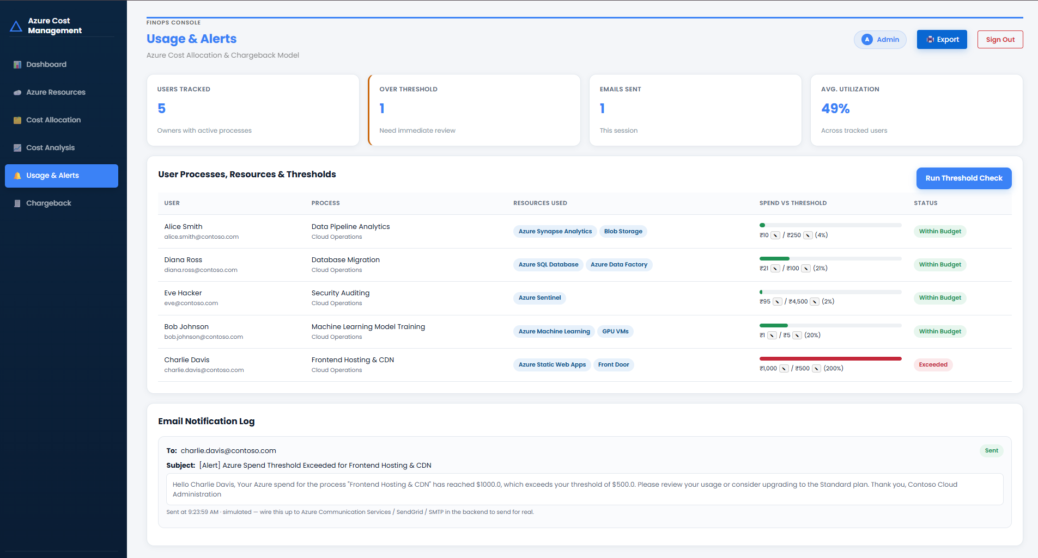
Cloud spend becomes actionable when ownership is visible
ALLOCATE
Allocate spend accurately
Allocate spend accurately to the departments that consume it.
PUBLISH
Make ownership reviewable
Publish a monthly chargeback report that makes cost ownership reviewable.

Slide 3

Chargeback turns shared consumption into accountable decisions
The model connects platform data to department action.
Collect Data
Map Costs
Publish Report
Act & Forecast

Slide 4
How a monthly chargeback moves from data to report
Two decision points route shared costs and disputes.
Set up tags
Label each resource
Get the cost data
From Azure billing
Fair cost sharing
Clear for everyone
One team's cost?
Save records
For future audits
No
Yes
Check it again
Fix if needed
Send report
To all teams
Shared cost
Used by many
Give to team
Full amount
Yes
Any complaint?
No
Split it fairly
By usage
Add it all up
One total per team
Make the report
Every month

Slide 5
The implementation workflow needs a clear rulebook
Every stage names the decision it must make.
01
02
03
04
Discover
Define
Publish
Resolve
Inventory subscriptions, services, tags, and shared costs.
Agree on allocation drivers and treatment of unallocated spend.
Issue the monthly chargeback report.
Handle disputes through a visible review path.

Slide 6
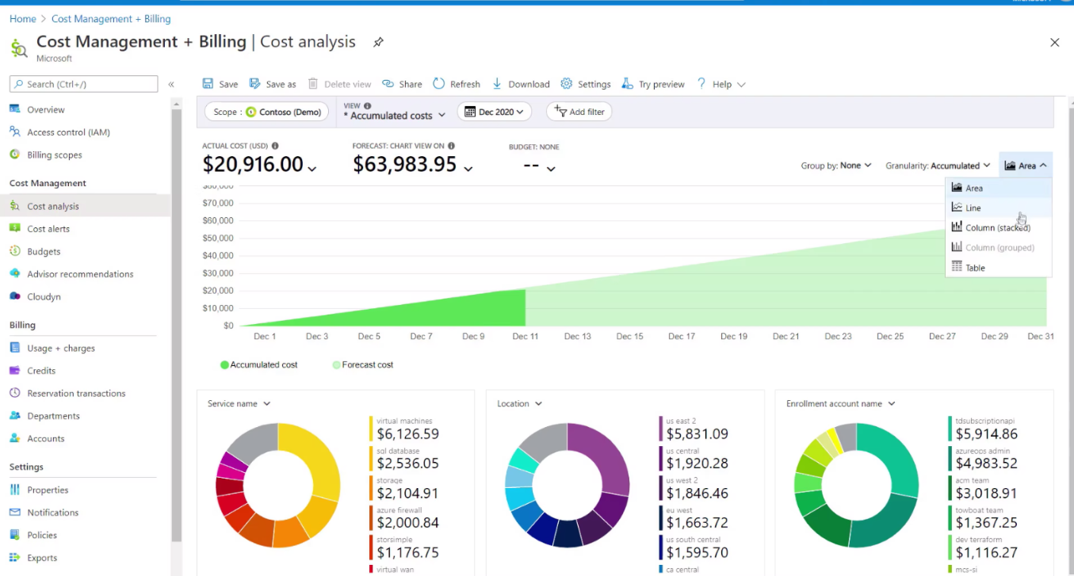
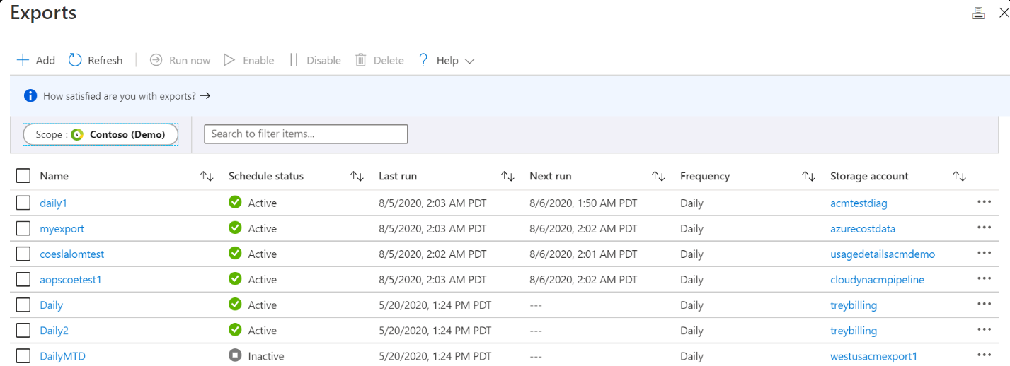
Two use cases anchor the model
Start with the work that makes ownership visible every month.
USE CASE 01
USE CASE 02
Allocate all spend
Publish monthly reporting
Connect platform consumption to the right department.
Create a repeatable view of cost ownership and variance.
Reference cohort: 2 teams, T095 and T197, with 8 students.

Slide 7
Two bottlenecks can weaken trust in the numbers
Risk · what can weaken trust
Control · what makes the method defensible
RISK 01
RISK 02
Shared platform costs
Methodology disputes
Common services resist clean allocation.
Departments may challenge how costs are assigned.
Control: Make the method explicit: document allocation drivers, show exceptions, and give departments a predictable path to challenge or correct an allocation.

Slide 8
Student checklist: make every monthly report defensible
Prepare
Define
Publish
Review
1
Inventory shared and department-specific services.
2
Define allocation drivers before the first report.
3
Document treatment of unallocated or shared platform costs.
4
Publish the report on a repeatable monthly cadence.
5
Track disputes, decisions, and methodology changes.

Slide 9

OPERATING PRINCIPLE
Remember the operating principle
Good chargeback is accurate enough to trust, transparent enough to explain, and repeatable enough to operate every month.

